Slide 1
Running an import profile in a member institution with Use Network Zone
and "Upon Match" is "Use NZ Record"
Yoel Kortick
Senior Librarian

Slide 2
Agenda
Introduction
The import profile
The sample record in the Network Zone
The sample record input file for the import profile
The results of the import
Another example with a slightly modified import profile
2

Slide 3
Introduction

Slide 4
Introduction
In this presentation we will demonstrate what happens when the following conditions exist:
  A record with a specific match identifier exists in the Network Zone and is "Held By" only "Member Institution A".
  A record with the same specific match identifier does not exist in "Member Institution B" and as already stated it is not "Held By" "Member Institution B" in the Network Zone.
  "Member Institution B" imports this record with the same specific match identifier via an import profile which has the following defined:
    Use Network Zone
    Upon Match Use NZ Record

Slide 5
Introduction
In the example here we have a network zone and three member institutions:
Member / Network | Name | Inst. Code
Network | Ex Libris University Consortium | EXLDEMO2_INST
Member | Alma University | EXLDEV1_INST
Member | Open University | EXLDEMO3_INST
Member | University of Knowledge | EXLDEMO1_INST

Slide 6

Introduction
Network Zone
Ex Libris University Consortium
Member Institution
Alma University
Member Institution
Open University
Member Institution
University of Knowledge

Slide 7
Introduction
We see from the example in this presentation that:
  If a member institution of a Network Zone consortia creates an import profile with “Use Network Zone” and “Upon Match” is defined as “Use NZ Record”, then
    If the member institution imports a bibliographic record that matches a record in the Network Zone, then
    A duplicate record will not get created
    There will be an additional “Held By” on the bibliographic record in the Network Zone for the member institution.

Slide 8
The import profile

Slide 9
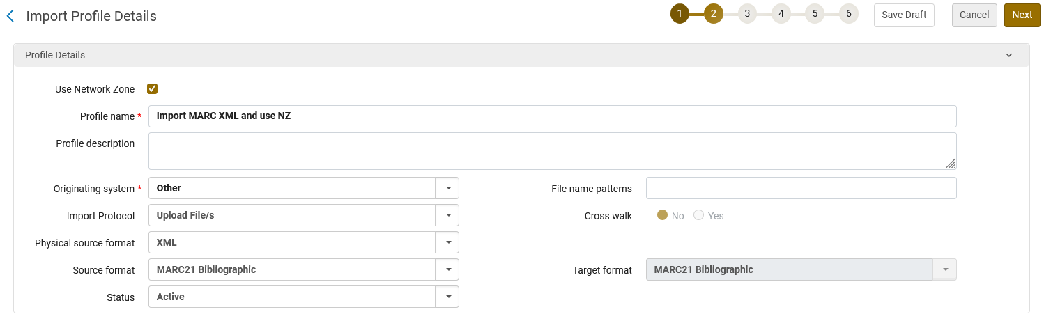
The import profile
In member institution "Open University" we create an import profile of type "Repository" at "Resources > Import > Manage Import Profiles"
The import profile states "Use Network Zone"

Slide 10
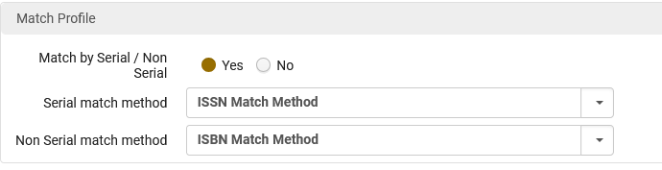
The import profile
The match profiles are "ISSN Method" and "ISBN Method".
Match methods for Serials and Non Serials

Slide 11
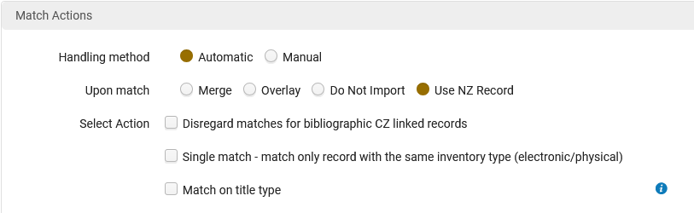
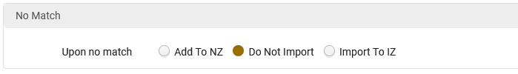
The import profile
The Handling Method is "Automatic".
The "Upon Match" is "Use NZ Record"
According to Managing Import Profiles, the option "Use NZ Record" means "Use NZ Record (for Network Zone member institution only) – Discard the new record and instead use the record from the Network Zone."
Upon "No Match" there will be no import

Slide 12
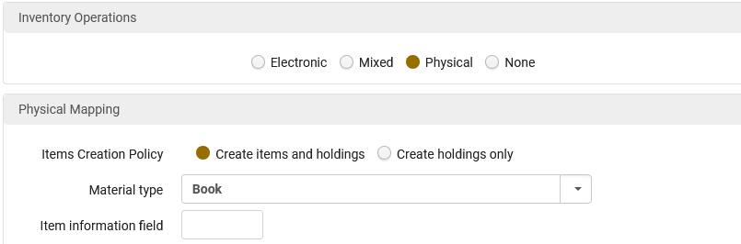
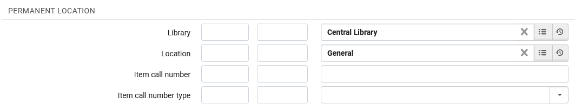
The import profile
The import profile will create physical inventory in Open University
Physical inventory will be created in Open University in the Central Library General Location.

Slide 13
The sample record in the Network Zone

Slide 14
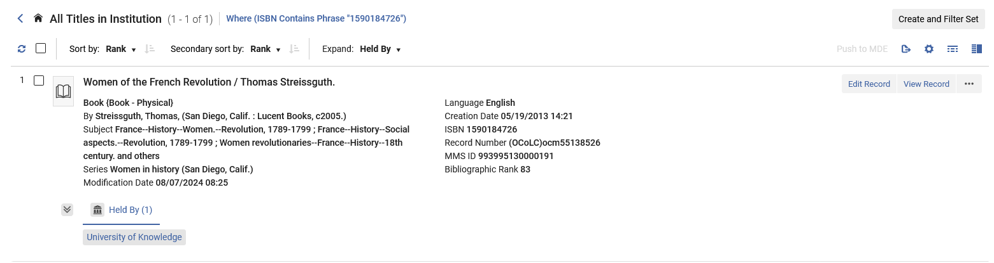
The sample record in the Network Zone
Title "Women of the French Revolution", ISBN 1590184726, MMSID 993995130000191, is in the Network Zone and "Held By" member institution "University of Knowledge"
"Held By" one member institution: "University of Knowledge"

Slide 15
The sample record input file for the import profile

Slide 16
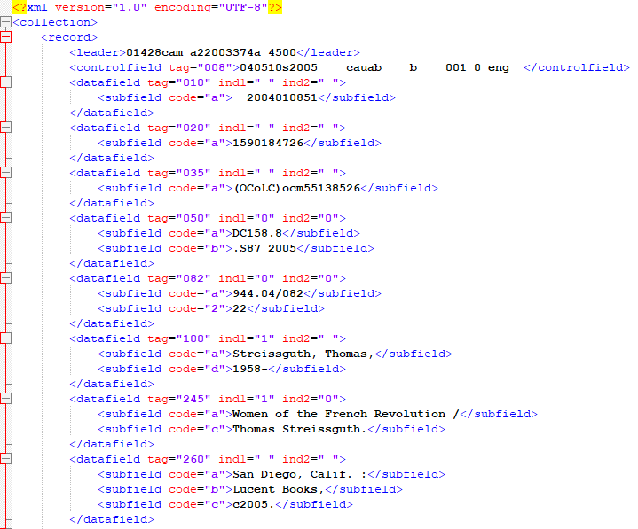
The sample record input file for the import profile
This is the file which will be loaded via the import profile.
It has ISBN 1590184726
This ISBN exists in the Network Zone, and we stated:
Use Network Zone
Upon Match Use NZ Record
so, there should be a match.

Slide 17
Running the import profile

Slide 18
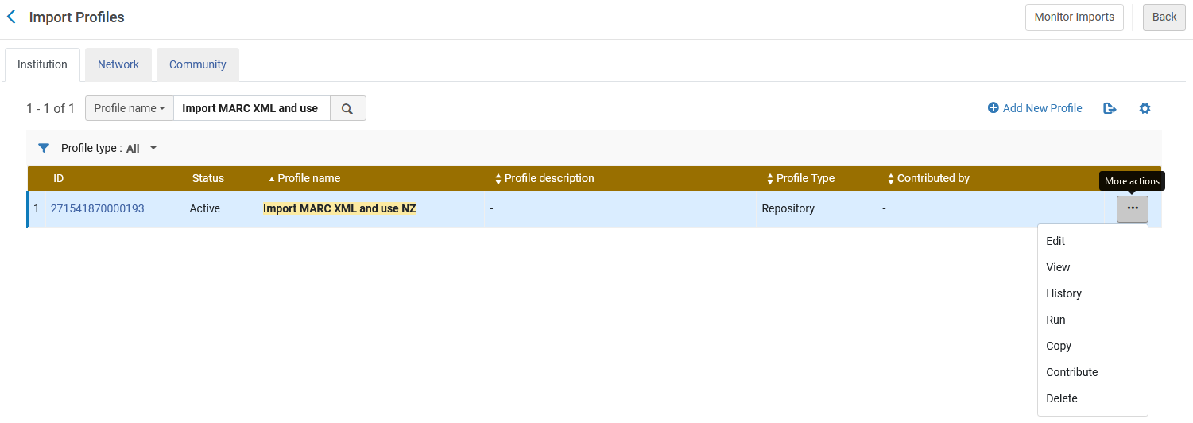
Running the import profile
In member institution Open University, we will now import the sample input file using the sample import profile, both of which we have just now seen

Slide 19
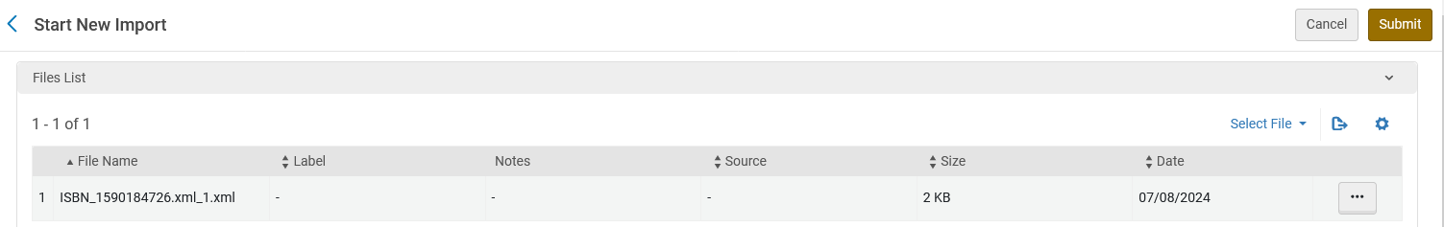
Running the import profile
We import the sample input file we have just now seen

Slide 20
The results of the import

Slide 21
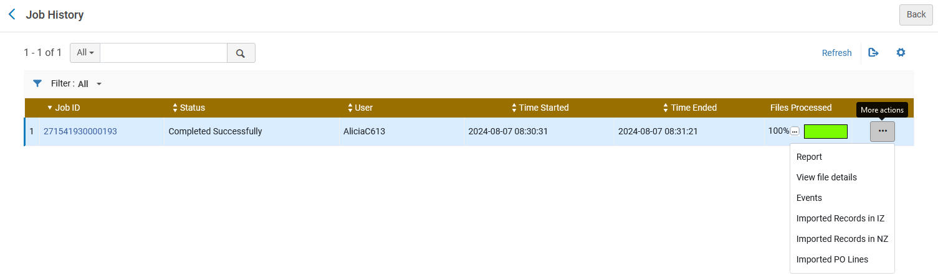
The results of the import
The import completes and we check the report of the job

Slide 22
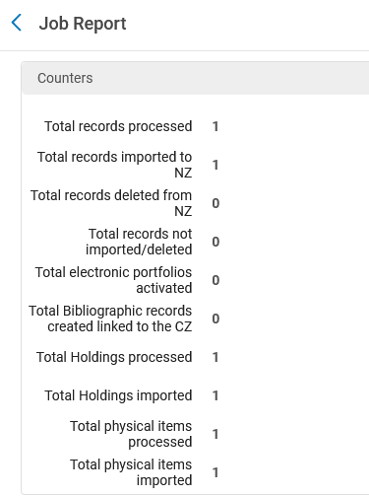
The results of the import
The job states that one record was processed and was imported to the Network Zone

Slide 23
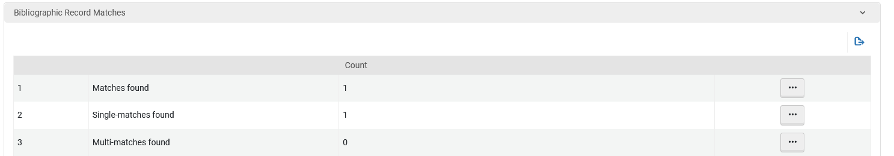
The results of the import
We also see that there was one bibliographic match

Slide 24
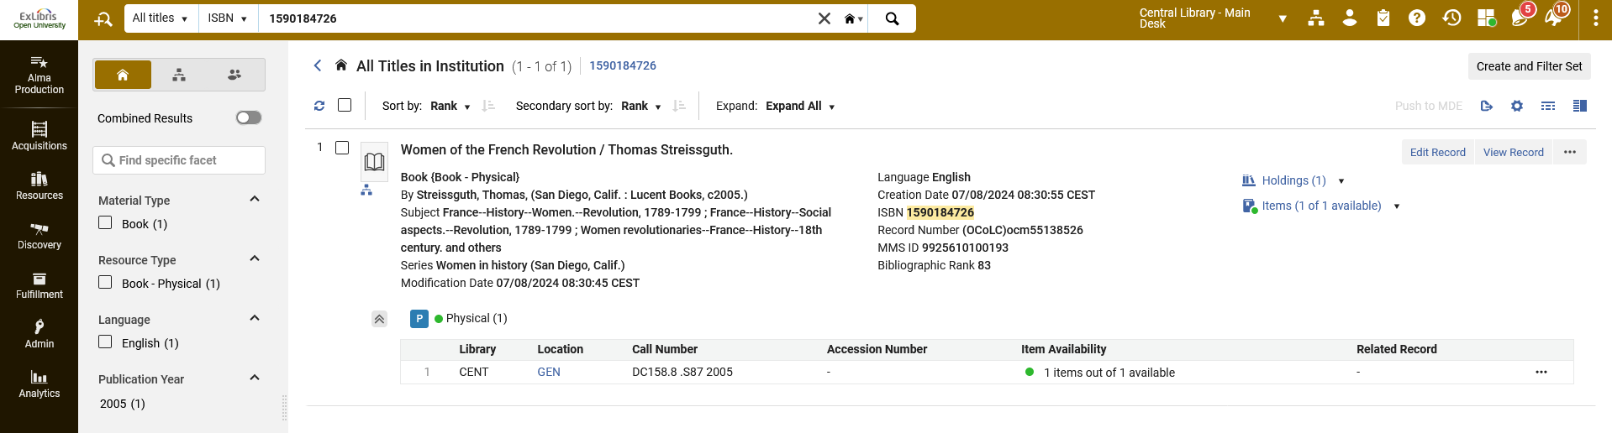
The results of the import
If we now search member institution Open University for ISBN 1590184726 we see that there has been a link made to the Network Zone. There is not a "duplicate" record in both the member institution and the network zone.
Link to Network Zone from the member institution
Inventory was also created as defined in the import profile

Slide 25
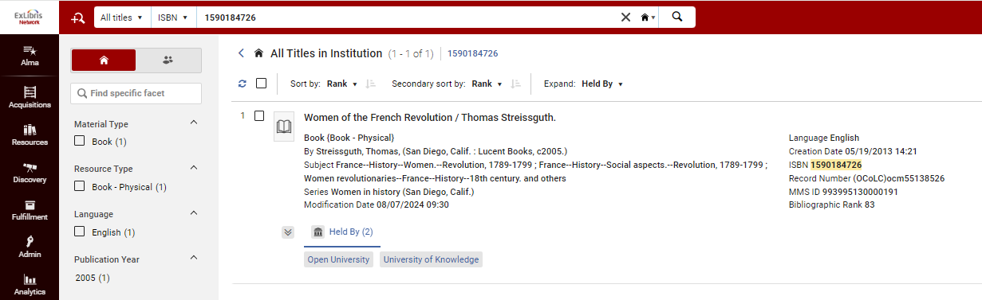
The results of the import
If we now search Network Zone institution for ISBN 1590184726 we see that it is "Held By" both "Open University" and "University of Knowledge". Previously the record was held only by "University of Knowledge". There is not a "duplicate" record in both the member institution and the network zone.
Network Zone institution
"Held By" both "Open University" and "University of Knowledge

Slide 26
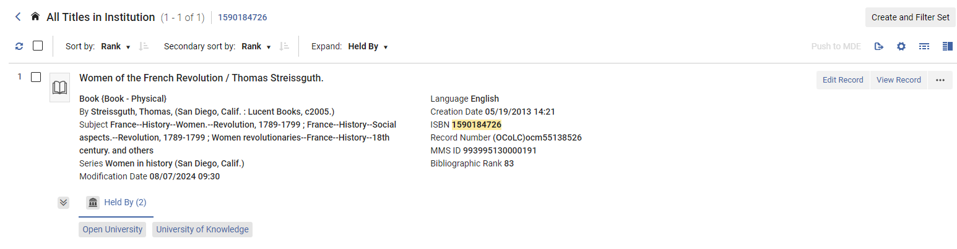
The results of the import
Record in Network Zone before the import
"Held By" only "University of Knowledge
Record in Network Zone after the import
"Held By" both "Open University" and "University of Knowledge

Slide 27
A slightly different import profile

Slide 28
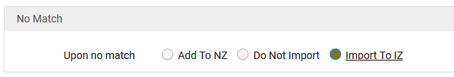
Another example with a slightly modified import profile
We now have a different import profile which is the same as the previous one we used except that in the “Match Profile” tab we state that if there is no match then “Import to IZ“.
In the previous example we stated that if is there is no match then “Do Not Import”
Now we state:
“No Match” = “Import to IZ”

Slide 29
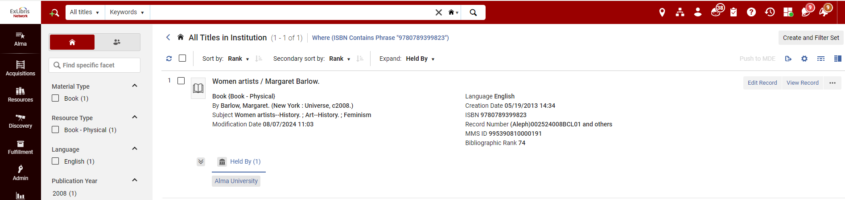
Another example with a slightly modified import profile
In the Network Zone institution, we have ISBN 9780789399823 and it is held by one member institution: Alma University

Slide 30
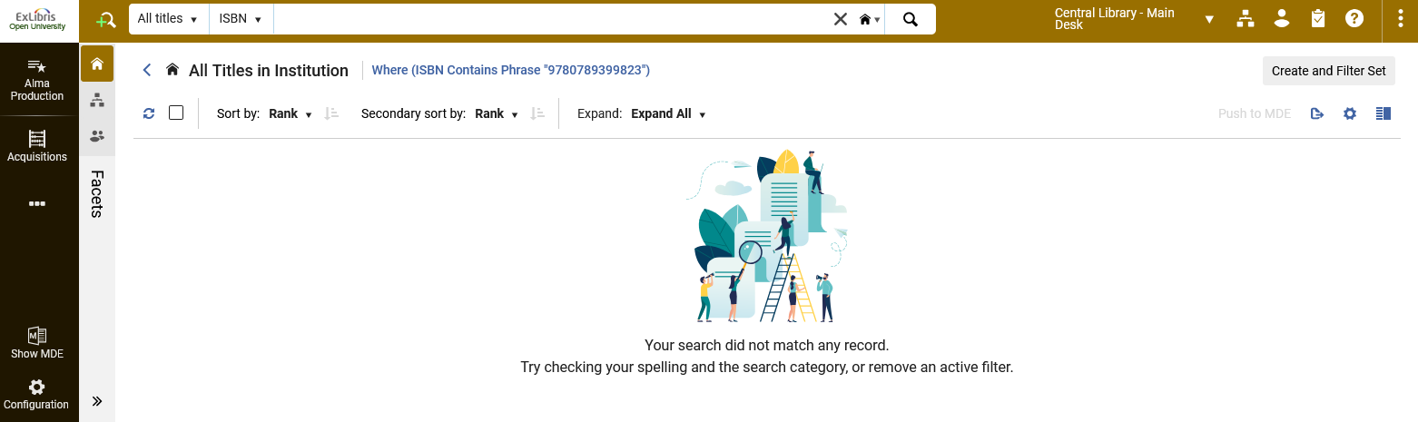
Another example with a slightly modified import profile
In the Member Institution Open University ISBN 9780789399823 does not exist

Slide 31
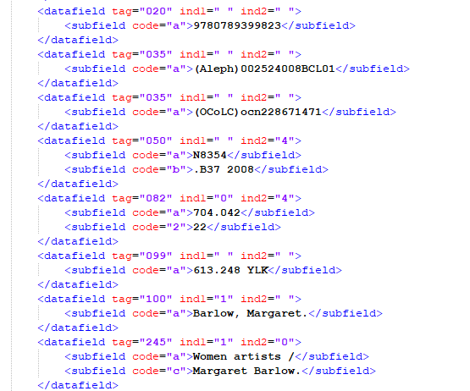
Another example with a slightly modified import profile
We have an input file which contains ISBN 9780789399823

Slide 32
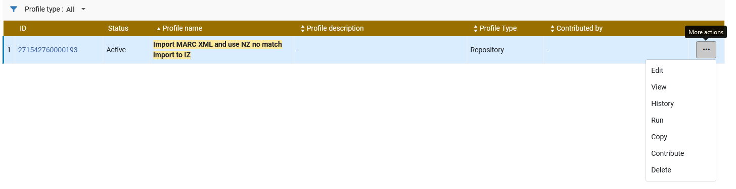
Another example with a slightly modified import profile
In Open University we use the new import profile (which has “No Match” = “Import to IZ” to load the input file.

Slide 33
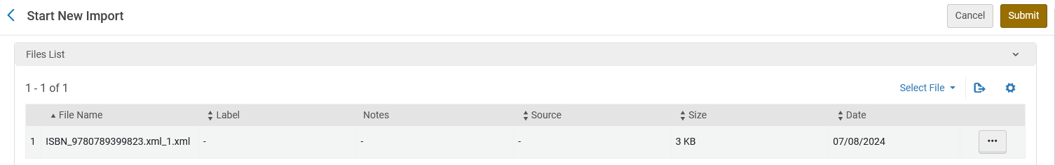
Another example with a slightly modified import profile
In member institution “Open University” we load the input file with ISBN 9780789399823.

Slide 34
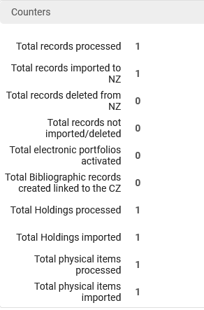
Another example with a slightly modified import profile
The job completes and the report states that there was 1 record processed and 1 record imported to the NZ

Slide 35
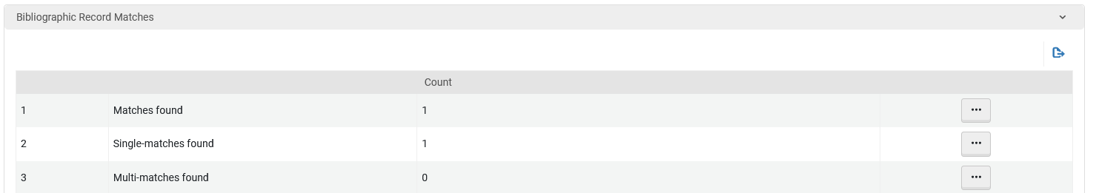
Another example with a slightly modified import profile
The report also states that there was one bibliographic match

Slide 36
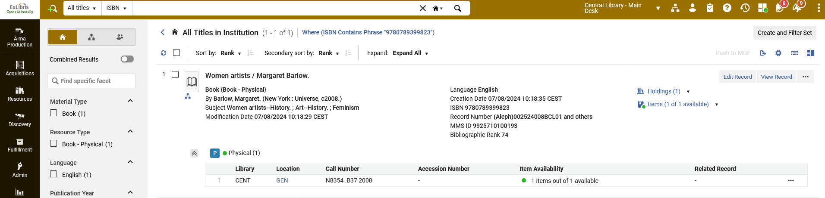
Another example with a slightly modified import profile
If we search member institution “Open University” for ISBN 9780789399823 we see one record and it is linked to the Network Zone.

Slide 37

Another example with a slightly modified import profile
If we search the Network Zone institution for ISBN 9780789399823, we see one record and it is “Held By” member institutions “Alma University” and “Open University”.
Previously it was held by only “Alma University”.
No duplicate records were created.

Slide 38
Thank You

